Slide 1
Assignment 4
Assignment 4
You will read and fill out the Security and Training Policy Document
Submit this!
You will then create a memo announcing the policy update to your organization
Submit this!
You will then create the actual training from the given topics in power point format
5-8 slides
Submit this!
You have TWO weeks to complete

Slide 2
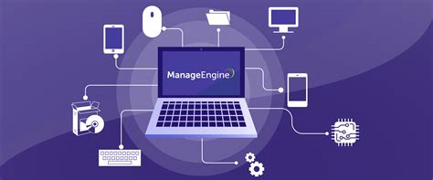
Asset Management
ITAM (Information Technology Asset Management) is the process of ensuring an Organizations assets are accounted for, deployed, maintained, upgraded, and disposed of
An IT asset is either Hardware, Software, or Proprietary Information
Notes:
ITAM is the process an organization uses to manage their assets
These assets can be either hardware software or proprietary information
Hardware includes HDD SSD Server Chasis Memory sticks USB devices Network analyzers, CDs/ DVDs laptops desktops RSA tokens
Software regards to licenses distributed out to employees or on servers
Proprietary information could be training content or meeting notes

Slide 3
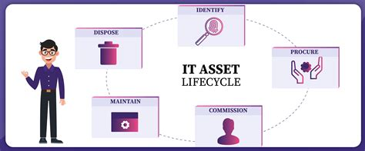
Life Cycle of an Asset
The life cycle of a single asset regardless of Hardware / software will be:
Identify
Procure
Commission / Distribute
Maintain / Update
Dispose (10 Years)
Notes:
You are going to identify the asset you need
You are going to then procure that said asset
You are going to bring that asset into accountability and distribute it
You will maintain that asset and service level agreement
You will then dispose of the asset once EOL occurs

Slide 4
ITAM Importance
ITAM is a major component for Risk Management
Gives security professionals visibility of the organizations assets
Allows for security professionals to know what is at risk for end of life
Conduct assessments
Have a centralized source of Updated IT Asset information
Allow for all asset information in one location
Gain better visibility of IT Assets
Can not manage what you do not know
Optimize Performance of IT Infrastructure
EOL assets / Upgrades
Maximize utilization of IT Investments and Expenditures
Avoid duplicate purchases and Underutilized resources
Notes:
ITAM is a function of Risk management because you need to know what the company has in order to assess its risk
Once you know you can now conduct your assessments for vulnerabilities and compliance
Having a centralized ITAM database is essential so that every business lines assets are located in one place which will allow for better visibility
We can then optimize certain assets that are outdated or prepare for EOL and replace
Sometimes assets can get lost in a company, we can then utilize these assets instead of making redundant purchases

Slide 5

Achieve ITAM
There are many applications out in the world to achieve ITAM
One thing to note is if you can automate something do it
If something already exists push the task on to a third party application
Software qualities to look for
Discovery and inventory features
ITAM Database
Supports the assets in your current environment
Enterprise Applications
SolarWinds Help Desk
ServiceNow IT Asset Management
ManageEngine AssetExplorer
MMSoft Pulseaway
Asset Panda
Notes:
There are many applications that can achieve and automate ITAM
When looking for applications that can achieve ITAM we want to look for applications that have Discovery features, ITAM Database for centralization, and supports the assets in our environment
Some enterprise applications we can use are:

Slide 6
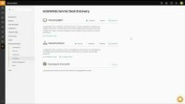
Notes:
SolardWinds Service Desk Application

Slide 7
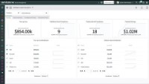
Notes:
ServiceNow ITAM

Slide 8
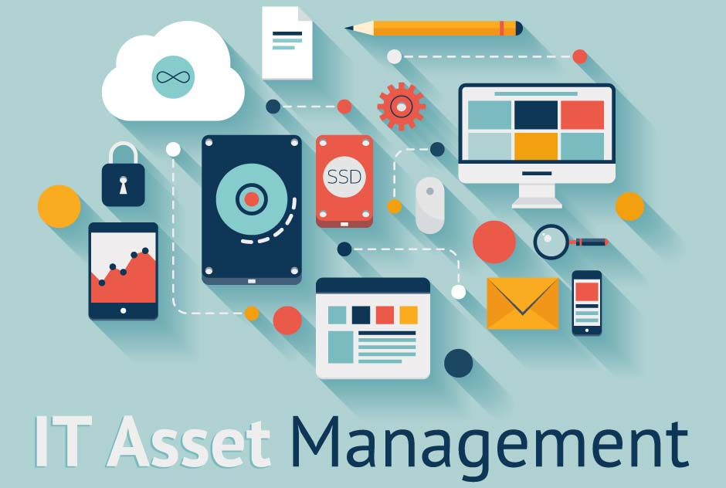
ITAM Categories
Organization will need to be aware of the following assets
Software Asset Management
Manage Licenses
Hardware Asset Management
Manage Hardware through Serial Numbers and Service Contracts
Mobile Asset Management
Manage Issued Phones, Tablets, Air card's
Cloud Asset Management
Manage cloud assets, contracts, Apps
Digital Asset Management
Manage company Videos, Images, Content
Notes:
Organizations require the following to be tracked Software license, Service contracts, Mobile devices, Cloud contracts and apps, and Proprietary information

Slide 9
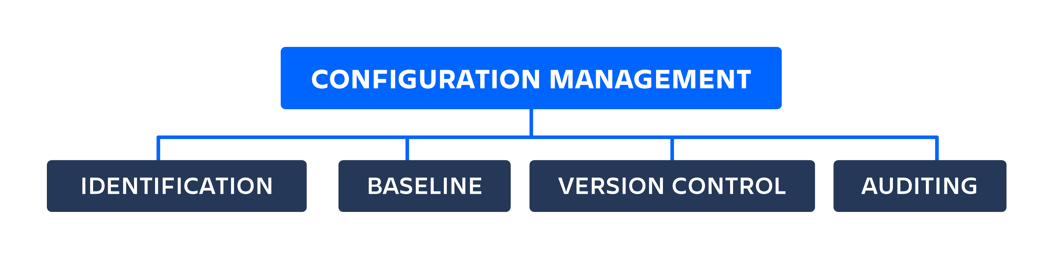
Configuration Management
“Configuration Management is a systems engineering process for establishing consistency of a products attributes throughout its life” –Atlassian
IT Configuration Management is the process of tracking Software and Hardware through its many iterations
SDLC part of CM
Factors that goes into Configuration Management
Identification
Baseline
Version Control
Auditing
Notes:
Configuration management is a process that tracks the different iterations of attributes throughout a products life
If anyone has ever heard of the software development lifecycle then this is a part of configuration management
When we look at configuration management it has four main parts
Identification of the application or product
Creating a baseline of that product or application
Utiliizing version control for that product
And constantly auditing that product for who made the changes and why

Slide 10
Why is this Important
Configuration Management is incorporated into Risk Management
Assists in the building robust and stable systems
Hardware CM
This will show the visibility of what HDD is located in what server in what datacenter
Software CM
This will create version control and allow for software to be more robust and updated on time
Notes:
Organizations conduct configuration management in order maintain robust and stable systems
It allows visibility for their hardware and easy swap outs
Software is a big player in configuration management especially if the company develops a software or conducts data analysis
Organizations also write many scripts in which can go through many iterations

Slide 11

CM Breakdown
Identification
Asset identification takes place through policy and Asset Management
RMF and CSF require this for compliance
Baseline
Created through policy
Achieved by Asset Management
Security Controlled
Version Control
Part of CM
Achieved through applications
Updates baseline
Notes:
We perform the identification function through Asset management. This is required by RMF and CSF frameworks
We can create a baseline through the organizations policies, asset management, and security controlling the baseline. This is the first stable iteration of a product
We want to utilize version control in order to update our baselines, make sure that we can revert the changes, and have visibility that the correct people are making the changes

Slide 12
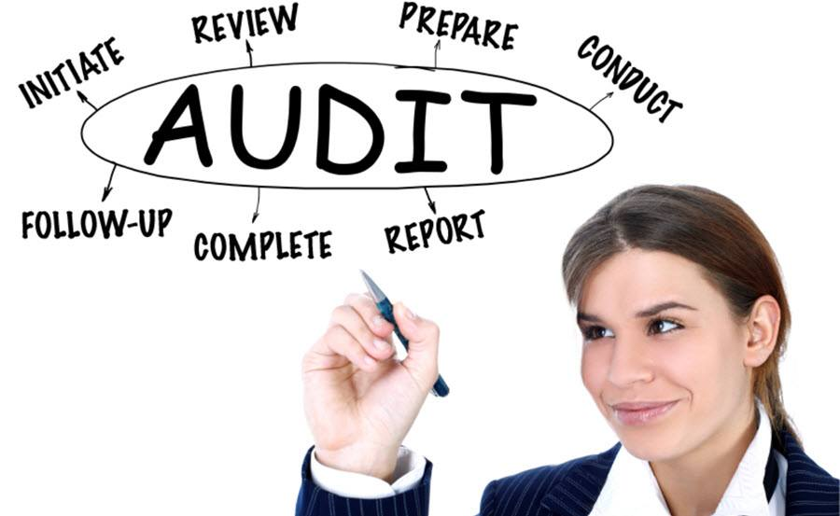
Auditing
Security audits version control
Personnel Access
Change modifications
Notes:
Auditing is required for all products to ensure that the correct people are accessing the systems / product who is making the changes and ensuring that everything has accountablilty.

Slide 13
Achieve Configuration Management
Enterprises utilize a variety of tools to achieve Configuration Management
We mainly think of CM as Software CM
Some of these tools achieve both HW and SW CM
Tools
Git
Chef
Puppet
Ansible
Docker
Podman
Terraform
SALTSTACK
Notes:
How can we achieve configuration management within an enterprise?
We want to use some sort of software in order to ensure configuration management is consisten through out the organization
We can use tools such as:

Slide 14
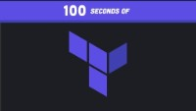

Slide 15


Slide 16
What is Risk?
Risk defined by NIST
“An effect of uncertainty on or within information and technology. Cybersecurity risks relate to the loss of confidentiality, integrity, or availability of information, data, or information (or control) systems and reflect the potential adverse impacts to organizational operations (i.e., mission, functions, image, or reputation) and assets, individuals, other organizations, and the Nation. (Definition based on ISO Guide 73 [6] and NIST SP 800-60 Vol. 1 Rev. 1 [7])”
Notes:
Risk is the measure of the potential outcome or event that may occur

Slide 17
Risk Equation Broken Down
Equation for calculating Risk
Risk = ARO X SLE
Annualized Rate of Occurrence
Single Loss Expectancy
Notes:
Risk can be measured by the equation of R = Annualized rate of occurrence time single loss expectancy

Slide 18
Example Risk
Company A has 10 Servers. Each server contains 24 HDD at 3.4 TB each. Through historical data Company A has determined annually that they lose 2 Hard drives a year out of the 10 servers. Each HDD costs 4K and takes about a month to arrive at the Company for replacement. What is the combined SLE and ARO?
2 HDD per Year x 4000 = 8000 per year of loss

Slide 19
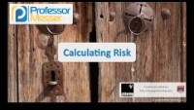

Slide 20
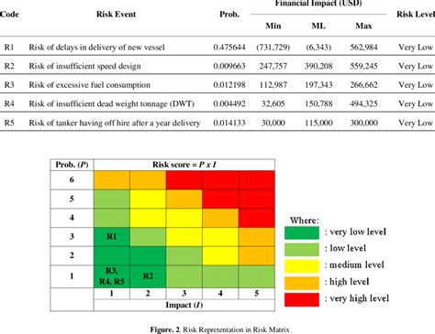
Evaluating Risk
Enterprise Risk is evaluated by Risk Registries
Projects for a company conduct Risk Assessment
Likelihood and possibilities are taken into account
Impact is assessed
Registry is laid out into a chart
Left column is likelihood of event
Top row is impact grade
Notes:
Organizations utilize Risk registries or heat charts to identify risk
For every project a risk registry is created in order to track those risks and opportunities
We assess impact for every risk and create a hierarchy
The left column of the heat map is the likelihood of the event occurring (probability)
The Top row is our impact assessment

Slide 21
Risk Types
Organizations incur risk on a daily basis
Types of risk organizations incur
Inherent risk
Residual Risk
Inherent Risk
A risk or event calculated with no controls established
Ie. Implementing third-party Cloud services
Residual Risk
A risk or event calculated with the controls in place
Ie. Implementing the cloud services with an organization firewall or load balancer in place
Remaining risk level is taken into account
Notes:
We have two types of risks that companies incur
Inherent risk is an event that is calculated with no controls established
Residual Risk is an event that has controls implemented for it or mitigations and then calculated. The execess risk is now the residual risk

Slide 22
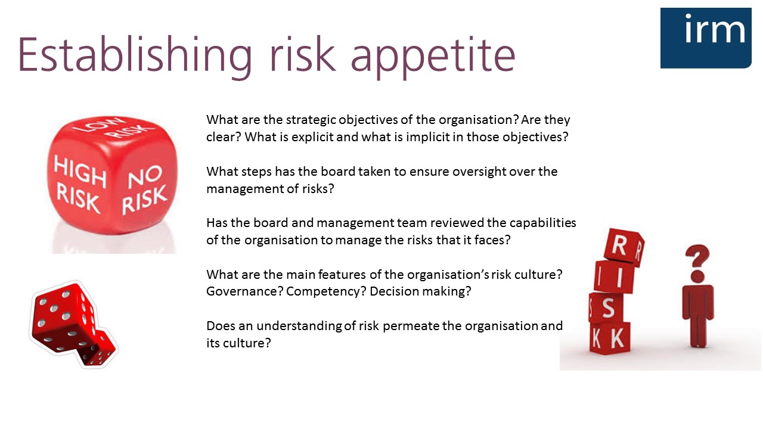
Risk Appetite
Organizations must establish how much risk they are willing to take on
Per project basis
Notes:
Organizations all agree upon some level of risk, which is their risk appetite
Every project that an organization begin will conduct some formal meeting to agree upon a certain level of risk, Most of the time this is already known by all party members and everyone know what they must do. This comes with experience at being a company and understanding what is acceptable

Slide 23
Assessment
Build Cybersecurity Requirements
Build the policies around the identified risks
Remediate risks through control implementation
Utilize configuration management for achievement
Automation should be used to complete technical controls
Formal audit
May need to bring in an internal penetration team
Security may assess posture through self-assessment
Notes:
Once we have our risk level agreed upon we begin by creating our security requirements and then implementing those controls.
This may require a formal audit in order to determine what controls are needed to mitigate each risk
Once again software and automation should be utilized when ever possible. DOD has many automation tools for compliance and the use of Gold images are making a comeback

Slide 24

IT Risk Awareness
Organization should be updating security training
Provide the knowledge to employees
IT is changing
Keep up to date on latest threats and technology
Intrusion protection systems have threat signatures that must be updated
Firewall rules need to be updated and tuned
Web Application Firewalls(WAF) must be tuned
Notes:
Organizations aare always facing new threats. Companies should be maintaining their training requirements in order to provide the required knowledge to the employees
Our IT world is always changing and everything must be constantly updated and maintained
Many applications require weekly updates and tuning

Slide 25
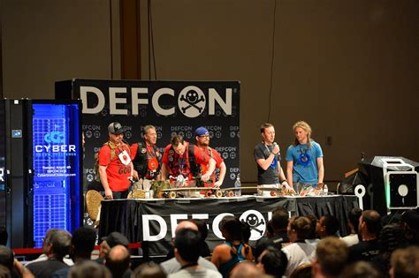
Conferences
As Security Professionals / IT Engineers Conferences are Important!
Conferences provide upcoming technologies
New Information / Research
Conferences:
DEFCON 2023
AWS re:Inforce / Invent
IBM GDS Security Digital Summit
CROWDSTRIKE FAL.CON Las Vegas 2022
Notes:
Organizations should have a separate budget or sometimes included with their training budget to send IT personnel to conferences
These conferences provide insight on new threats and research along with new technology

Slide 26
Regulations
Government regulations affect Risk management
Organizations must adhere to certain regulations in order to operate
HIPPA
Health Insurance Portability and Accountability Act
PCI DSS
Payment Card Industry Data Security Standard
SOX
Sarbanes-Oxley Act
TCPA
Telephone Consumer Protection Act
GDPR
General Data Protection Regulation (EU)
Notes:
Organizations face regulations depending on the industries they work in
Thes regulations affect the way organizations manage risk because their risk tolerance has to meet eye to eye with these regulations
Lets take Hospitals for example, They must adhere to HIPPA and most likely PCI DSS for payments
This now forces their risk tolerance to never be below these regulations thresholds or they can no longer do business

Slide 27
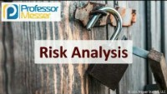

Slide 28
BACKUP

